Slide 1
Automated Pneumonia Diagnosis Using CNNs on Radiographic Images
Sameera Aluri

Slide 2
Problem to Investigate
GOAL: Automatically detect pneumonia in patients using chest X-ray images using a deep learning approach
PROBLEM STATEMENT: Can we build a deep learning model that accurately identifies pneumonia from chest X-ray images, distinguishing it from normal lungs?
OBJECTIVE: Train a CNN-based binary classifier to detect:
Class 0: Normal
Class 1: Pneumonia
MOTIVATION: Pneumonia is a major global health burden
Chest X-rays are diagnostic standard, but error-prone
AI can support faster, scalable, and more consistent diagnoses

Slide 3
Project Scope
Included
Binary classification (Pneumonia vs. Normal)
Deep learning models (custom CNN + pretrained model)
Image preprocessing & augmentation
Evaluation with standard ML metrics
Not Included
Multiclass disease classification
Clinical deployment or integration
Real-time image pipeline or API

Slide 4
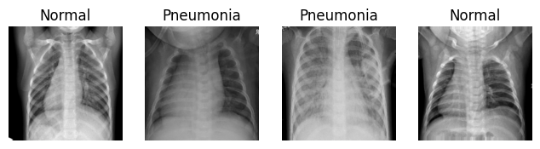
Dataset Overview
Source: Kaggle – Chest X-Ray Images (Pneumonia)
Image Type: Grayscale X-Ray JPEGs
Structure:
~5,200 training images
~600 test images
Labels: NORMAL or PNEUMONIA
Challenges:
Slight class imbalance
Variable image resolution
No patient metadata (pure image-based)

Slide 5
Measurable Objectives
Build a custom CNN model from scratch
Fine-tune a pretrained model
Evaluate with metrics: accuracy, precision, recall, F1 score, AUC
Use Grad-CAM to visualize decision regions

Slide 6
Key Approaches & Findings
CNN-Based Models
CheXNet (Rajpurkar et al., 2017)
121-layer DenseNet trained on ChestXray14 (adult)
AUC ~0.915 (matches radiologist-level accuracy)
Transfer Learning
Pretrained models (e.g., ResNet, VGG, EfficientNet)
Kermany et al., (2018) fine-tuned models on pediatric data
Achieved high accuracy with limited samples
Custom Architectures & Ensembles
PneumoniaNet (Alsharif et al., 2021)
Pediatric-specific CNN with ~99.7% accuracy
Qiuyu et al. 2024
Ensemble: DenseNet + EfficientNet + Attention
AUC > 0.95
Explainability
Grad-CAM (Selvaraju et al., 2017)
Visual heatmaps highlight regions influencing predictions
Essential for clinical interpretability

Slide 7
Comparing Methodologies
Study | Model | Dataset | AUC / Accuracy | Notes
Rajpurkar | DenseNet-121 | ChestXray14 (Adult) | AUC ~0.915 | Strong baseline
Kermany | VGG/ResNet (transfer) | Pediatric | ~93-95% | Few images, expert-level perf.
Alsharif | PneumoniaNet | Pediatric | ~99.7% | Custom CNN
Qiuyu | Ensemble (DenseNet + EfficientNet) | Pediatric | AUC > 0.95 | Uses attention modules
Cohen | ResNet | External Pediatric | AUC ~0.54 | Shows generalization issue

Slide 8
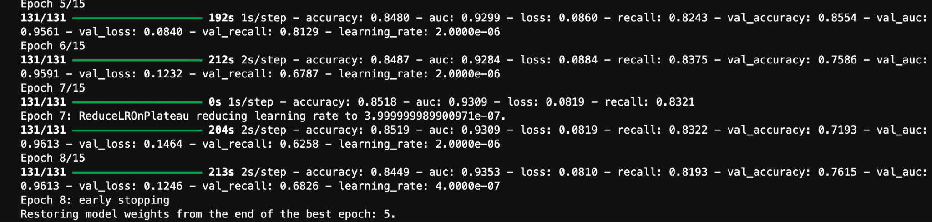
Model Architecture
Backbone: Pretrained ResNet50 (include_top=False)
Fine-tuning: Last 50 layers unfrozen
Input: 224×224 cropped X-rays (3-channel)
Head:
GlobalAveragePooling → Dropout (0.5)
Dense (128, ReLU) → Dropout (0.3)
Output: Dense (1, Sigmoid)
Loss: BinaryFocalCrossentropy (γ=2.0)
Optimizer: Adam (LR=1e-5)
Metrics: Accuracy, AUC, Recall
Imbalance Handling: class_weight + focal loss
Callbacks: EarlyStopping, ReduceLROnPlateau

Slide 9
Cropping Issue
Problem:
Original X-rays include non-lung regions (neck, shoulders)
Model sometimes focused on irrelevant areas in training
Led to overfitting and poor generalization especially for NORMAL cases
Solution:
Applied fixed lung-region cropping before training
Removed distractions and guided model toward relevant anatomy

Slide 10
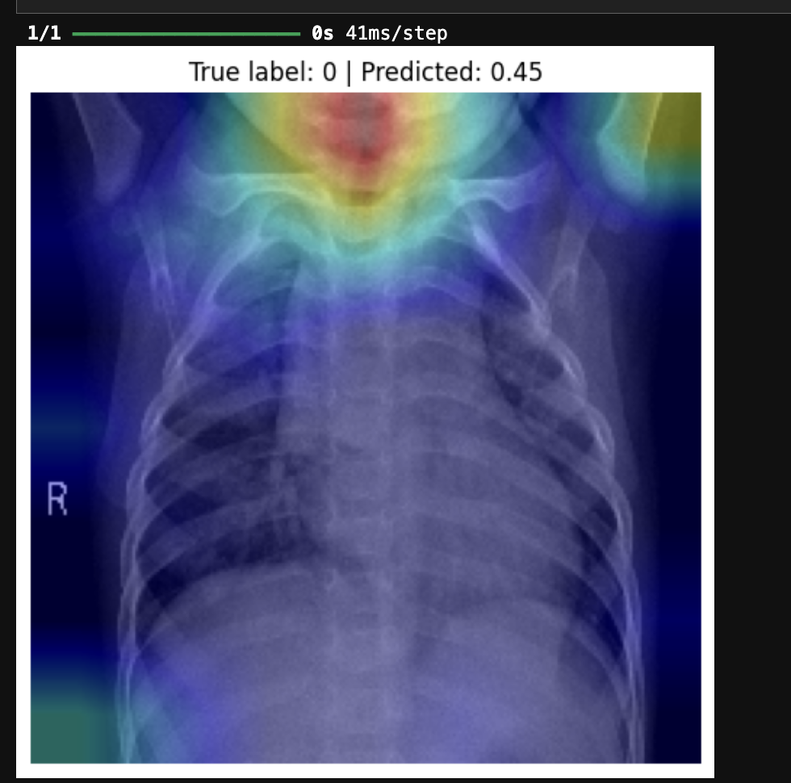
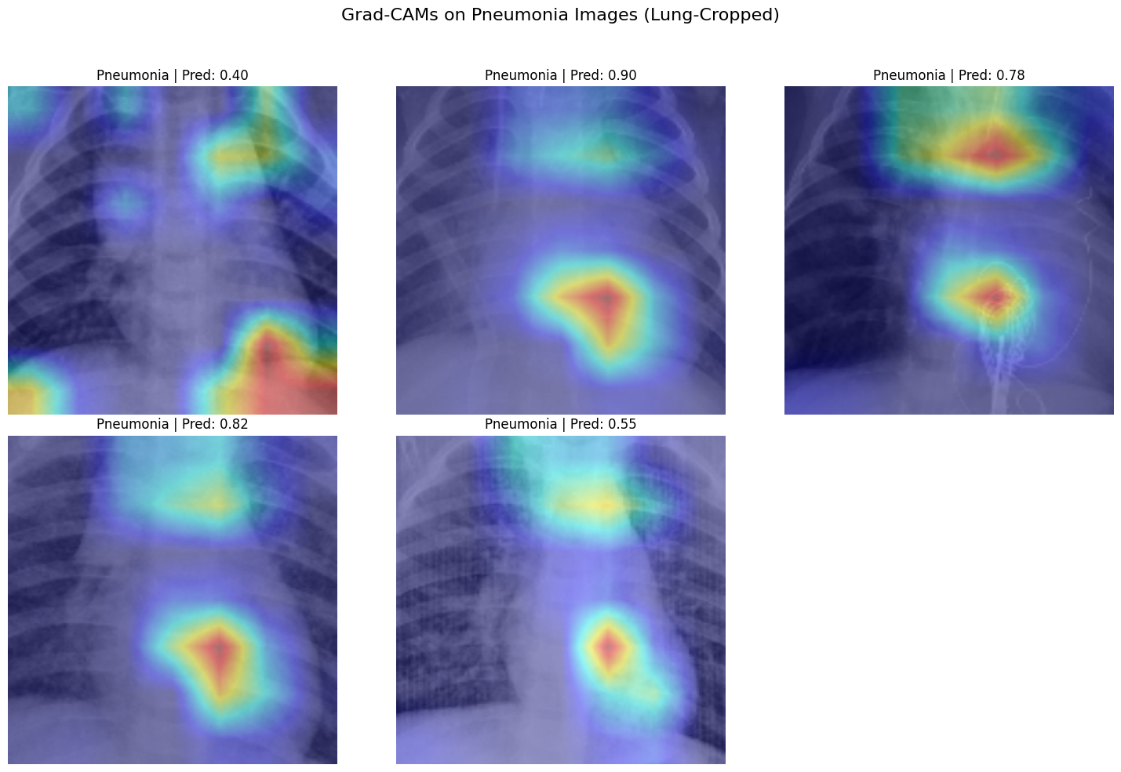
Before vs. After Cropping

Slide 11
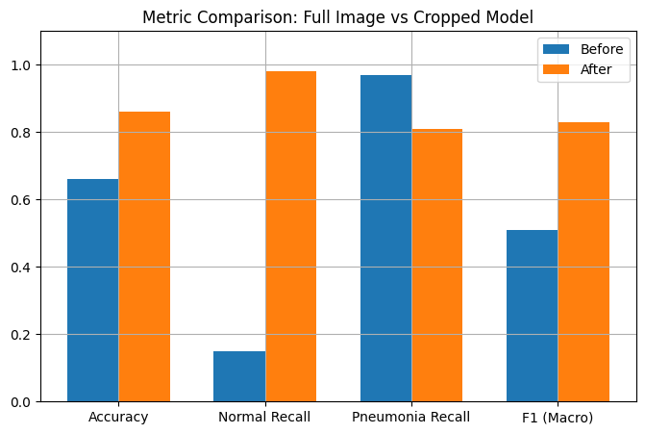
Before vs. After Cropping
 | Full Image | Cropped Image
Grad-CAM Focus | Neck, corners | Lungs, lower lobes
Normal Recall | 15% | 98%
Accuracy | 66% | 86%

Slide 12
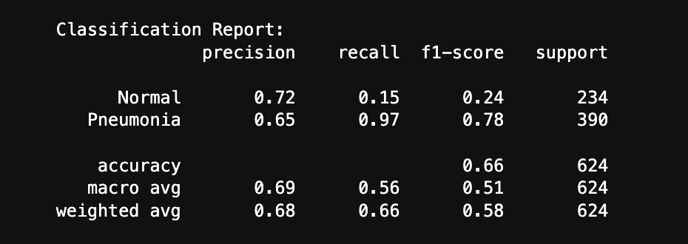
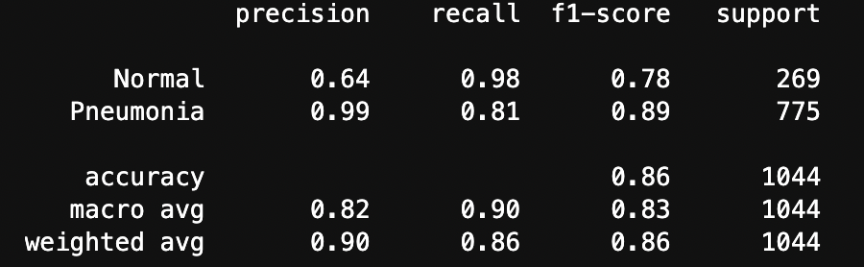
Evaluation Metrics & Results
BEFORE:
AFTER:

Slide 13
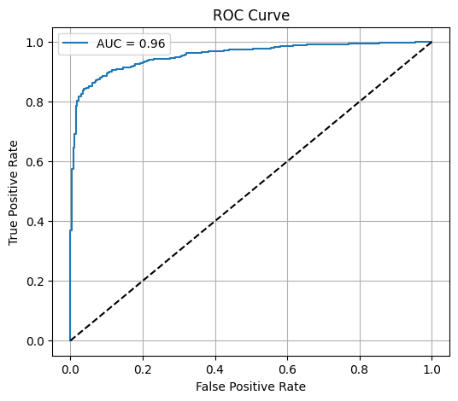
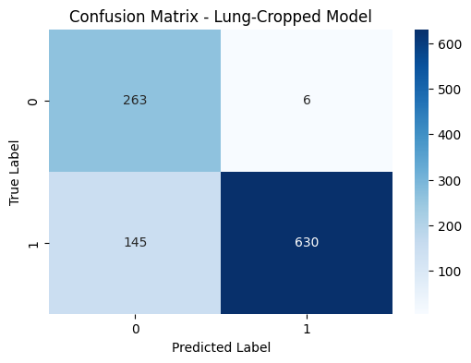
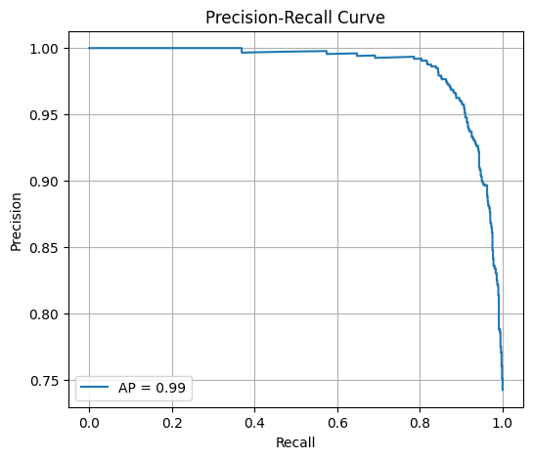
Evaluation Metrics & Results

Slide 14
Takeaways
Lung cropping significantly improved model focus and reduced overfitting
Class imbalance handled with focal loss + class weights
Normal class recall improved from 15% to 98%
Grad-CAM visualizations confirmed anatomically meaningful attention
Final model achieved 86% accuracy and 0.96 AUC
Outperformed baseline and matched or exceeded literature benchmarks
Demonstrated that simple preprocessing can drive large performance gains

Slide 15
Future Work
Integrate lung segmentation (U-Net) for dynamic, patient-specific cropping
Implement uncertainty estimation for clinical decision support
Expand to multi-class classification (e.g., bacterial vs viral pneumonia)
Fine-tune on larger or more diverse datasets for better generalization

Slide 16
Questions?

